Slide 1





UNIVERSITY MANAGEMENT SYSTEM
WARDIERE
BUSINESS
Submitted to:
Tasfia Tabassum Faija
Lecturer,
Dept. of CSE
Northern University Bangladesh
Submitted by:
Sumaiya Tabassum-1741
Md Abdullah-1758
Asoat Ali pramanik-1768
Tabassum Rahman Sigma-1770
PROPOSAL
Presented by:
Aaroon Loeb
1

Slide 2
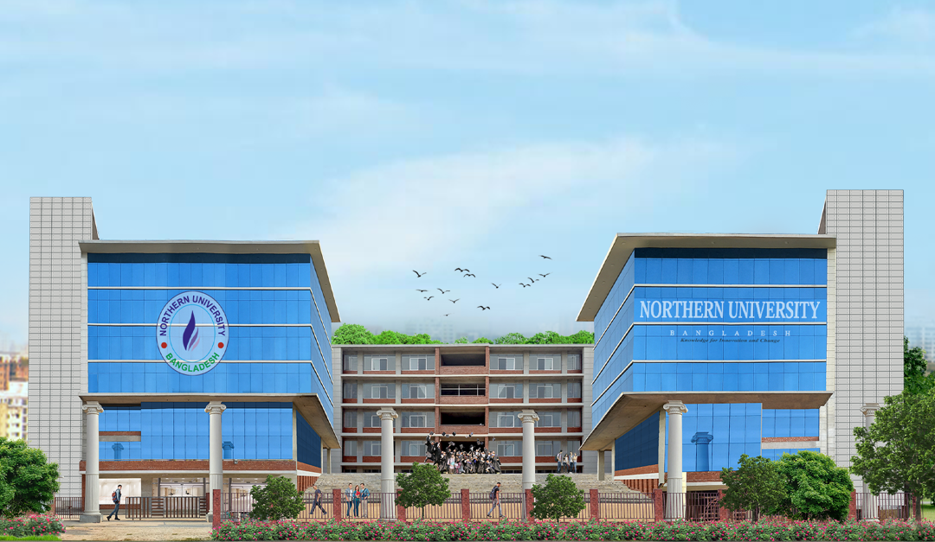
UNIVERSITY MANAGEMENT SYSTEM
AN INOVATIVE UNIVERSITY MANAGEMENT PLATFORM
2

Slide 3


THE CHALLENGE: MANAGING MODERN COMPLEXITY
Today's universities struggle with disconnected systems
Data Silos: Information trapped in separate departments
Manual Processes:Slow, error-prone grading, attendance, and finance tracking
Poor Student Experience:Frustrating library, transport, and payment systems Lack of Insight: Data is collected but not used for strategic decisions
~Result: Inefficiency, wasted resources, and
hindered growth
3

Slide 4
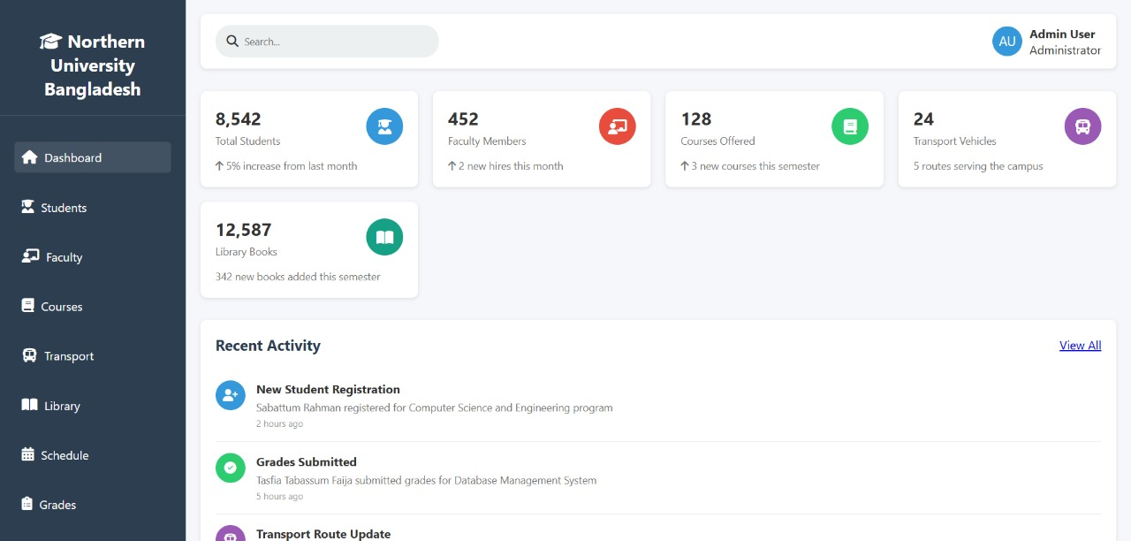
The Solution: A Single, Unified Platform
1.One Dashboard 2.Holistic Management 3.User-Centric Design 4.Informed Decisions
VISION
MISSION
4

Slide 5
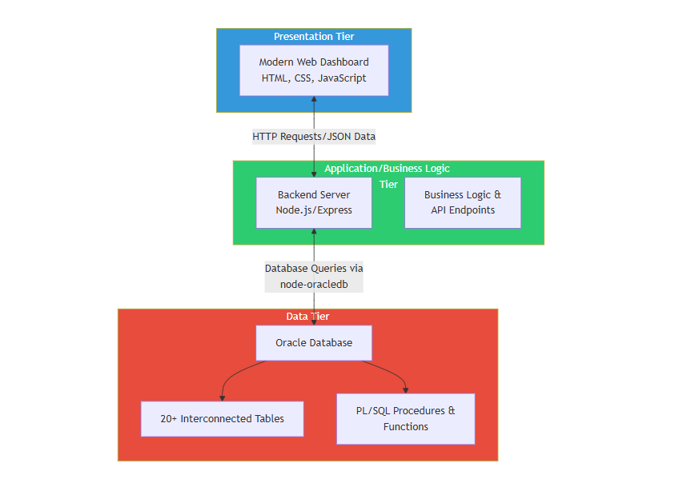
The Powerful Engine - Oracle Database
MISSION
5

Slide 6






Key Features & Modules -
Part 1
1.Academic Core
2.Financial Hub
3.Smart Library
6

Slide 7

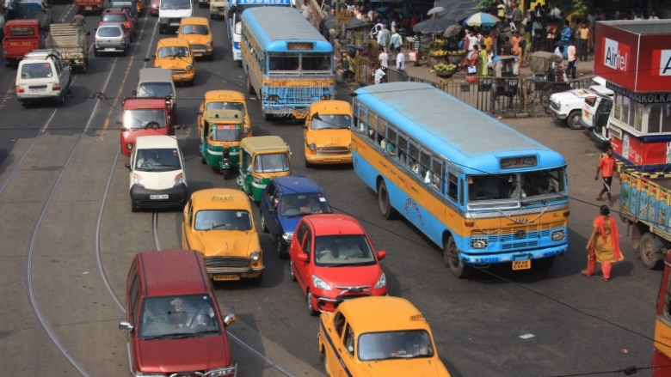

Key Features & Modules -
Part 2
SERVICE 01
SERVICE 03
Intelligent Transport System:
SERVICE 02
SERVICE 04
Advanced Analytics & Automation
7

Slide 8

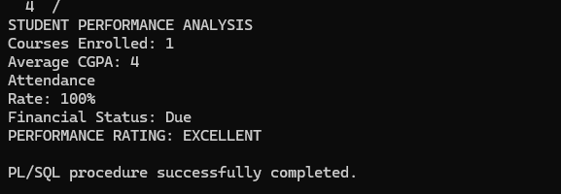
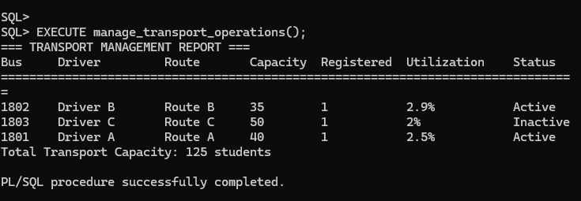
The Technical Advantage - Why Oracle PL/SQL
Three reasons:
1.Power
2.Reliability
3.Intelligence
8

Slide 9

Benefits
For Administrators: A 90% reduction in manual data entry and reconciliation. Complete oversight from a single pane of glass.
For Faculty: Streamlined grading and attendance, freeing up time for research and teaching.
For Students: A modern, transparent experience where they can focus on learning, not logistics.
For the Institution: Data-driven decision-making, reduced operational costs, and a significantly enhanced reputation
9

Slide 10
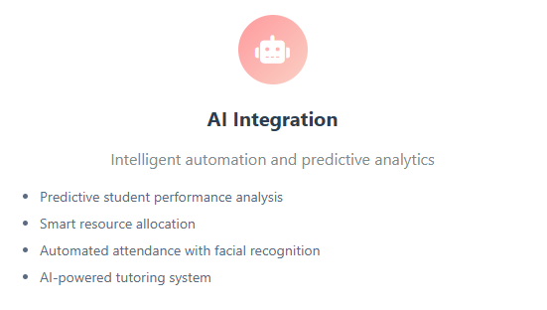
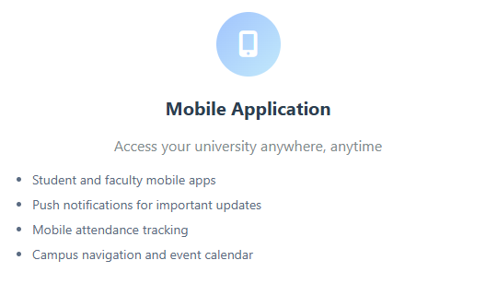
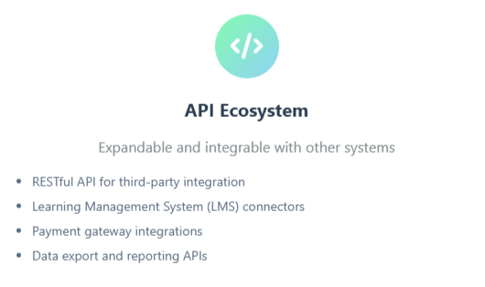
Future Development Roadmap
10

Slide 11

THANK
YOU
reallygreatsite.com
11

